Slide 1
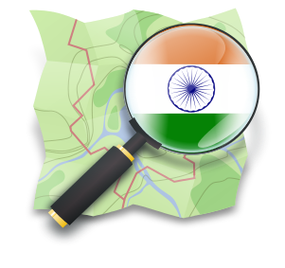
OSM India
Naveen Francis
OSM Volunteer (osm username : naveenpf)
Founding Member, OpendataKerala
Puzzle:
1.How many districts in India are not connected with Indian Railways ?
2. Which are the taluks in Rajasthan without hospital ?
Notes:
‹#›

Slide 2
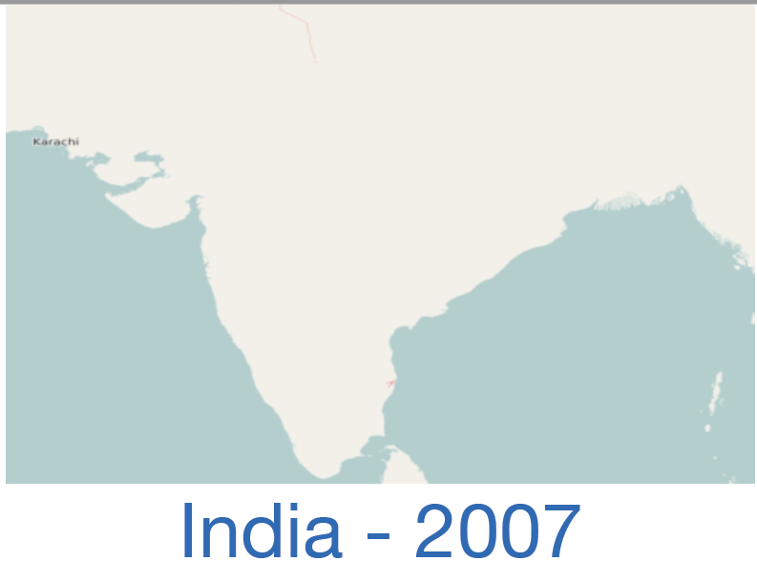
The Map

Slide 3
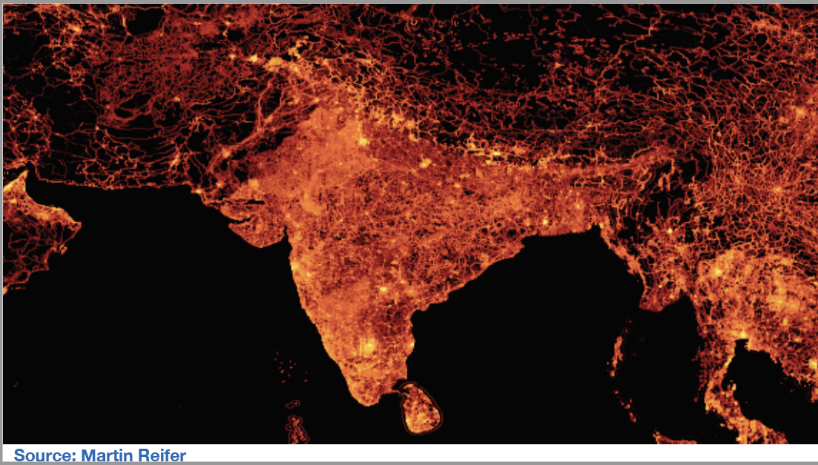

Slide 4
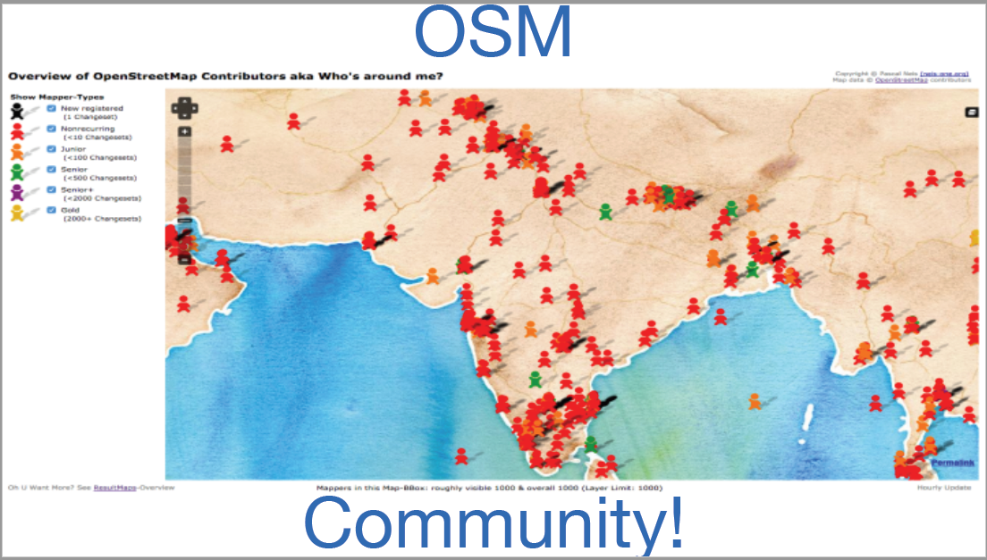

Slide 5
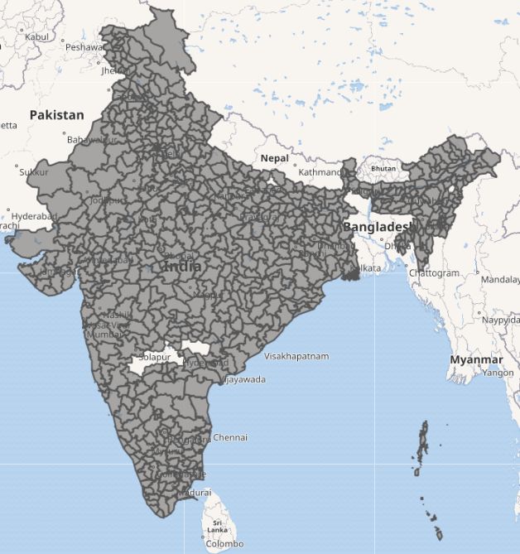
Districts in India
2024 → 785 districts,
2011 → Census of India 640
2001 → Census of India 593
https://wiki.openstreetmap.org/wiki/Districts_in_India

Slide 6
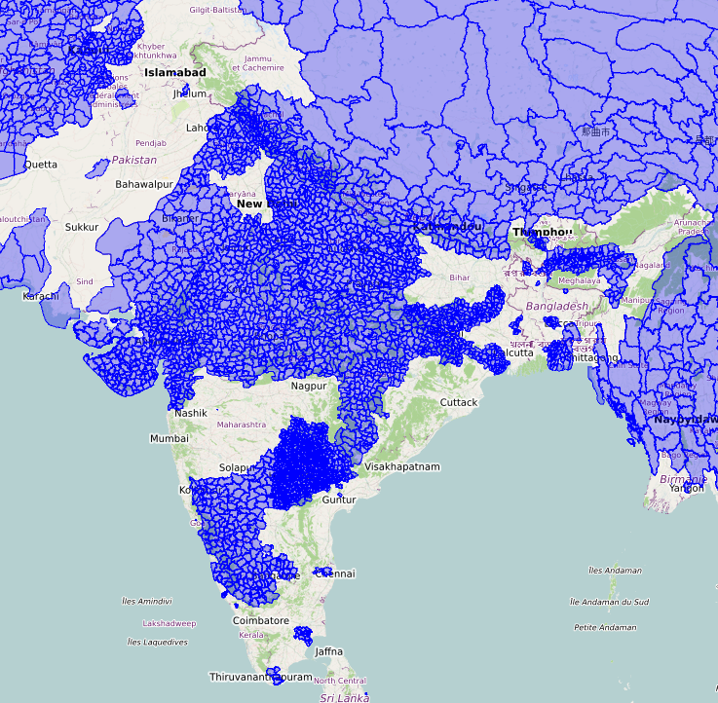
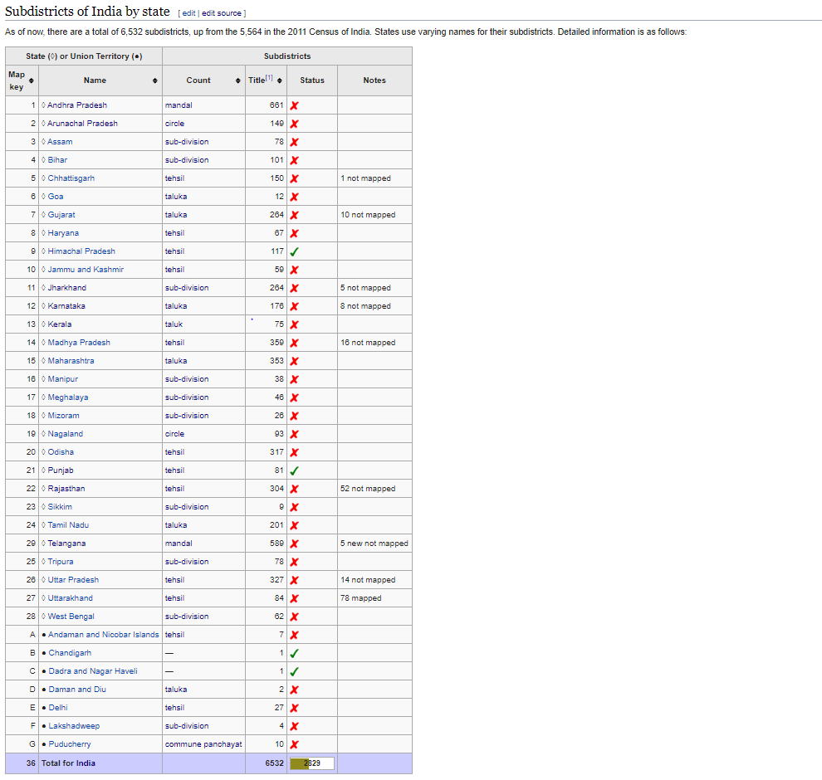
Sub-Districts in India
7129 taluks
6490 mapped till now
https://wiki.openstreetmap.org/wiki/Subdistricts_in_India

Slide 7
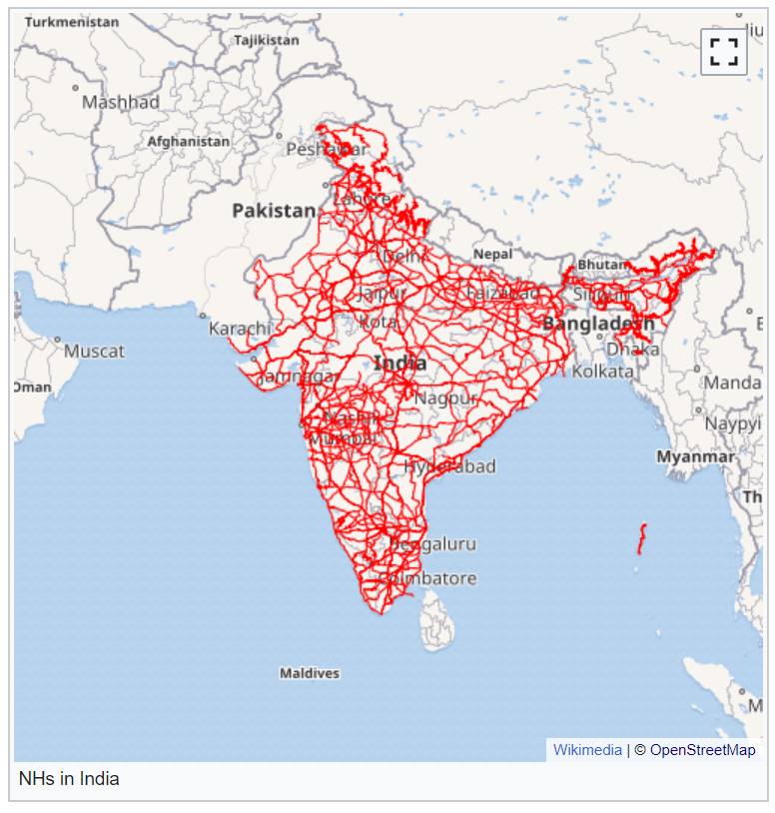
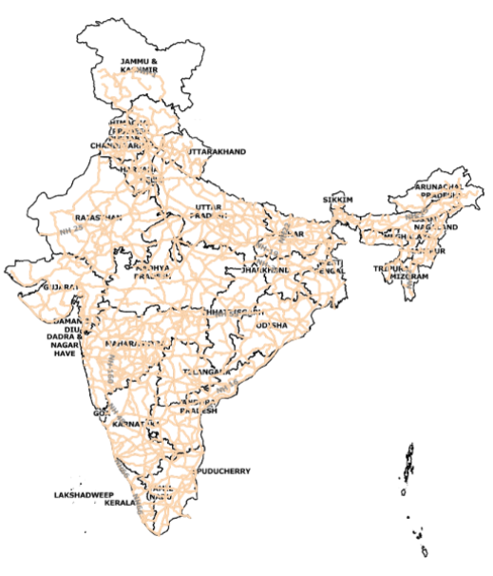
National Highway Mapping
MORTH Website:- 1,44,995 km
In OSM :- 1,36,023 km
https://wiki.openstreetmap.org/wiki/India/National_Highways_(statewise)

Slide 8
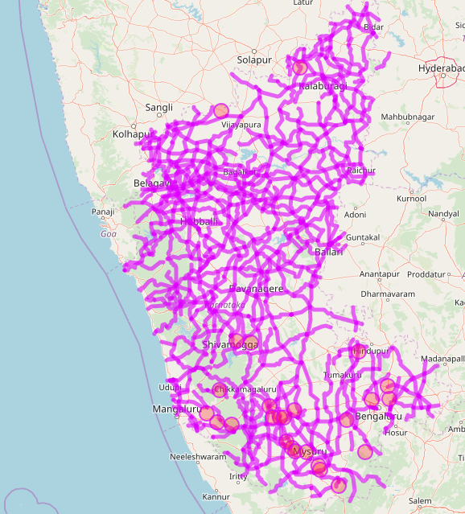
State Highway Mapping
https://wiki.openstreetmap.org/wiki/India/Roads#State_highways

Slide 9
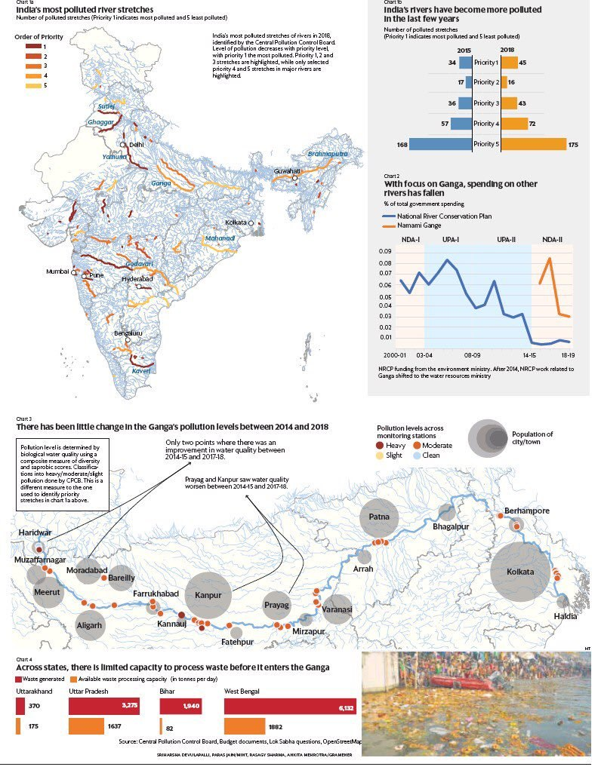
Water resources

Slide 10
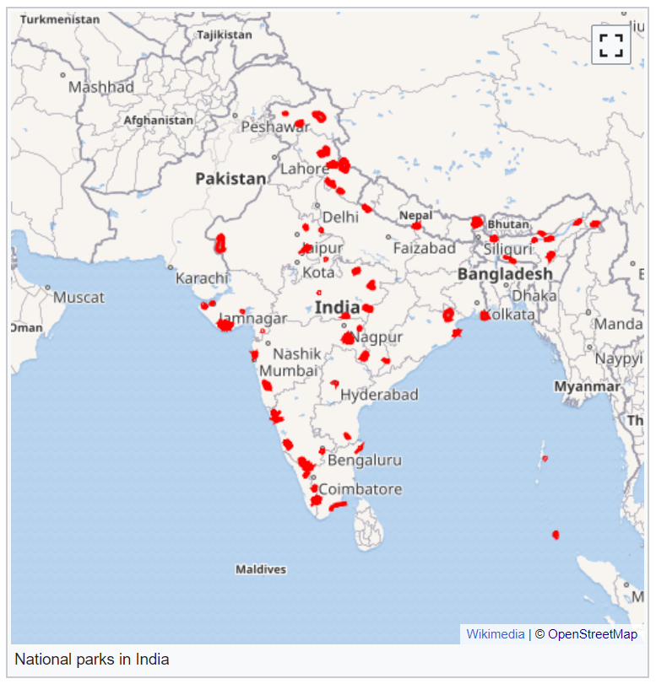
National Parks in India
104 national parks
IUCN category II protected areas
https://en.wikipedia.org/wiki/List_of_national_parks_of_India

Slide 11
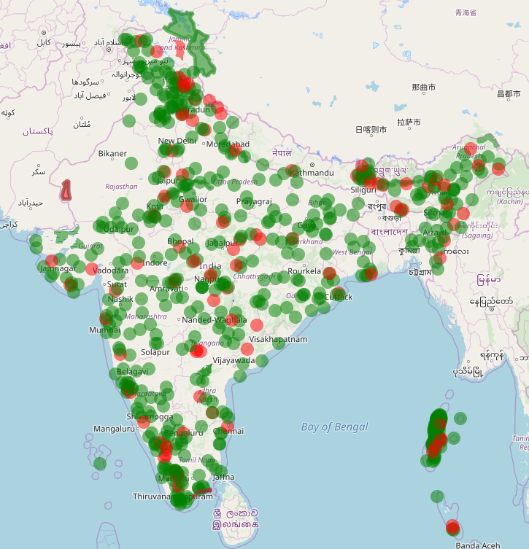
• IUCN category IV protected
areas
543 wildlife sanctuaries
referred to as wildlife
sanctuaries category IV
protected areas.
Wildlife sanctuaries in India
https://en.wikipedia.org/wiki/List_of_national_parks_of_India

Slide 12
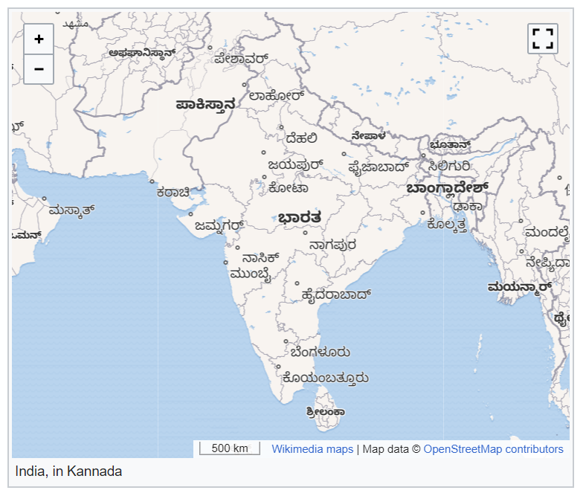
Map internationalization
<mapframe latitude="21" longitude="78" zoom="5" text="India, in Hindi" zoom="4" width="500" height="400" align="left" lang="hi" />
276 Wikipedias !!!

Slide 13
Wikimedia Maps
OSM powers WMF’s Kartotherian map tile service, which is used by the Kartographer MediaWiki extension and almost all other interactive maps on Wikimedia projects.
Map internationalization launched everywhere—and embedded maps now live on 276 Wikipedias

Slide 14
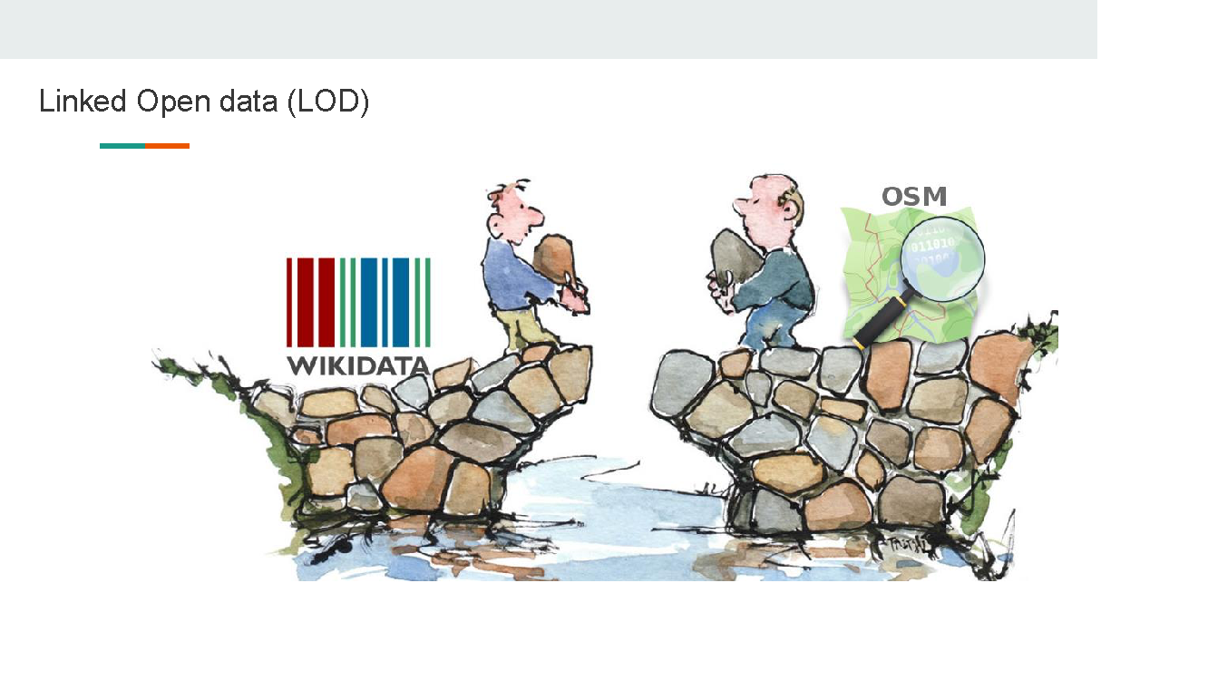

Slide 15
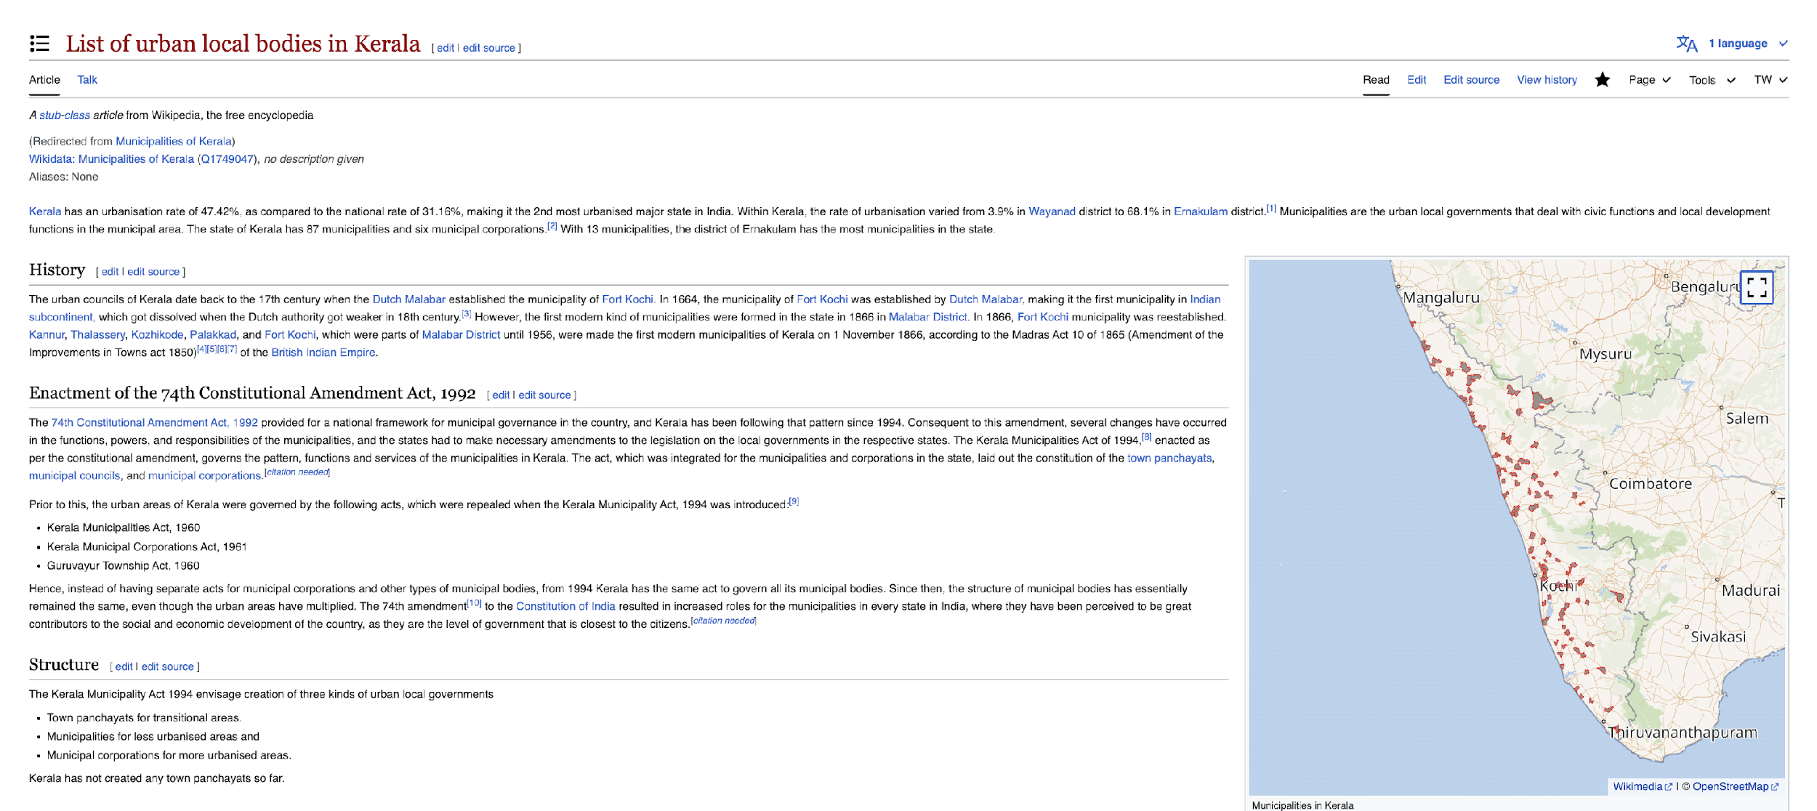

Slide 16
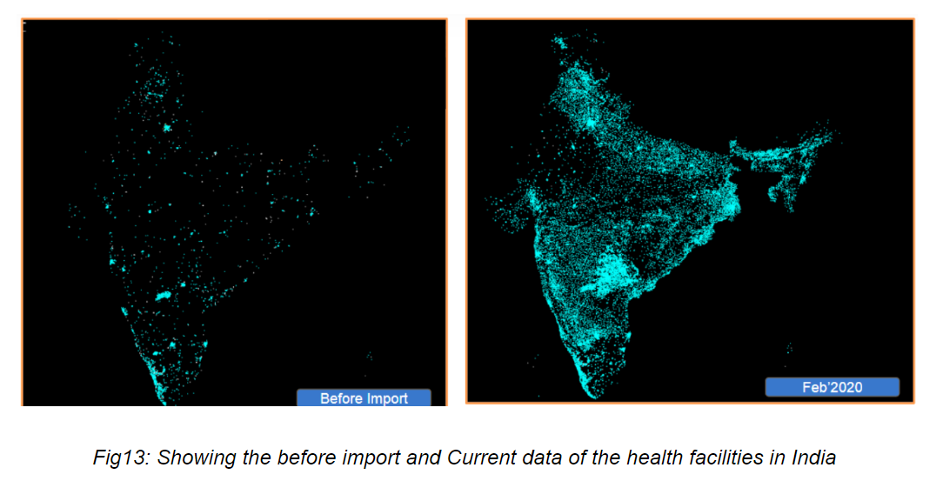
Health Facilities Import
https://www.openstreetmap.org/user/OSM_RMSI/diary/392364

Slide 17
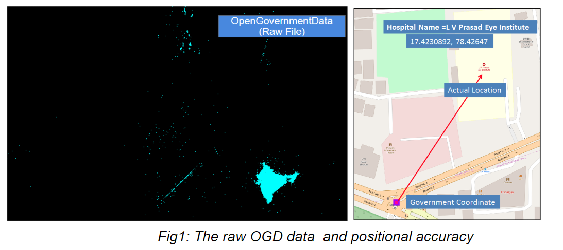
Challenges

Slide 18
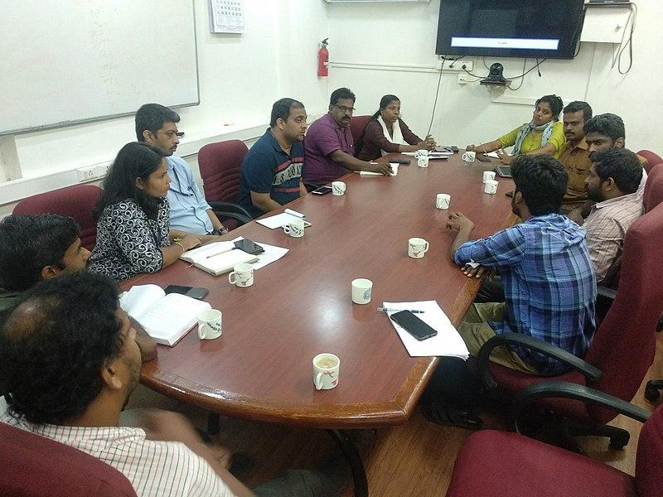
Mapathon Kerala
It is being coordinated by the Kerala State IT Mission, with the concept of Let Us Make Our Map.
Through the Mapathon Keralam, the Government of Kerala aims to create extensive local maps of Kerala including physical infrastructure natural resources and other information that are useful for planning and other developments.
The project is being led by the Kerala State Spatial Data Infrastructure (KSDI) under the Kerala State IT Mission and supported by other institutions
OSM Kerala community members urgued the need of improvement of OSM data in Kerala post floods in 2018.
Community members sumbitted the proposal to release important datasets in Opendata license.
https://mapathonkeralam.in/

Slide 19
Mapathon Kerala
MAJOR ACTIVITIES
Trainings
Promotional Material Development
Technical Infrastructure Development
Training/ Workshops
Recognitions and rewards
Pilot Projects
Panchayath Mapping sessions
Municipality Mapping sessions
Corporation Mapping sessions
Master Training for NSS – (109 Nos) Geography/Geology Trainers - (128 Nos) Government Departments – (517 Nos) Other Trainer Training – (129 Nos)
NSS MK Campaign training – 7 Nos (1101 Nos)
Internship Training programs – (280 Nos)
Recent updates in OSM
+55,150 Buildings
+38,100 Km Stream/Rivers
+1308,000 Km Road
+94,800 Amenities
+10,600 Schools
+1,375 Quarries
+27,000 Ponds
+2,706 Akshaya Centers/Sub-centers
+950 Police Stations
+1,151 Public Health institutions
+5,500 New Mappers in OSM.

Slide 20
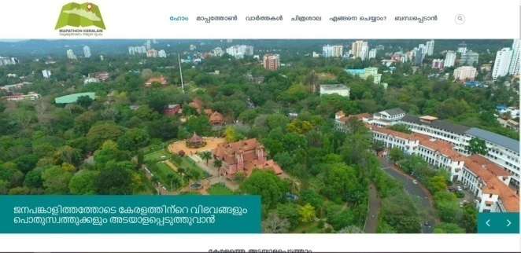
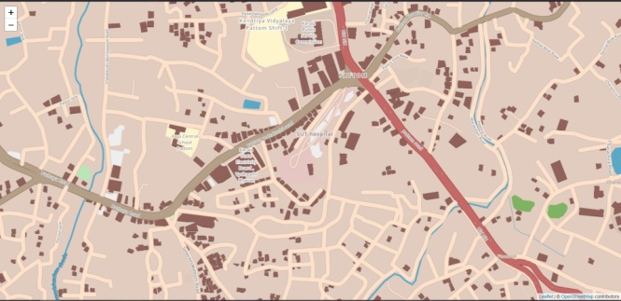
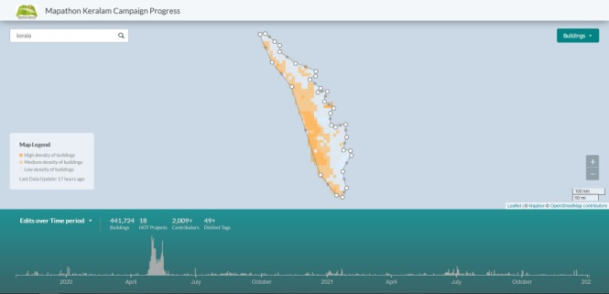
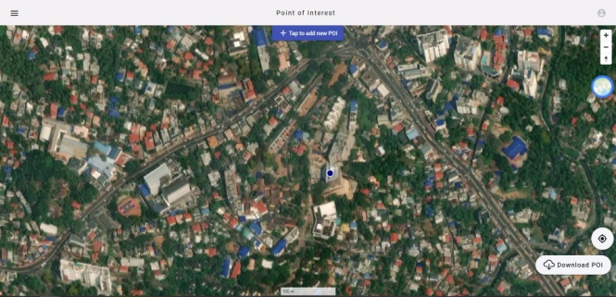
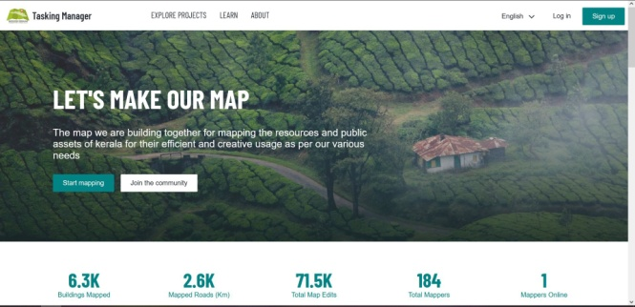
Mapathon Kerala - Major Tools Developed
Mapathon Keralam Webportal
Mapathon Keralam Tasking Manager
Mapathon Keralam Analytics - Campaign Progress Tracking System
Mapathon Keralam PoI Data Capture System
Geo-spatial Survey Application
Mapathon Keralam Leader Board
OpenStreetMap Tile Server
MK Webportal
OSM Tile Server
MK Analytics
MK PoI Mapper
MK Tasking Manager

Slide 21
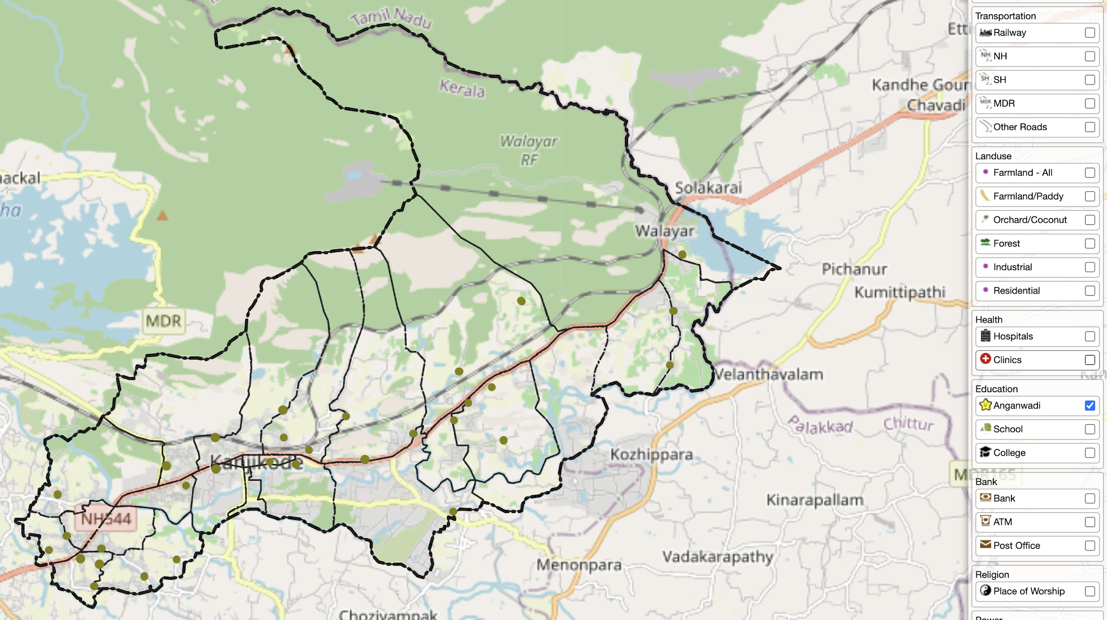
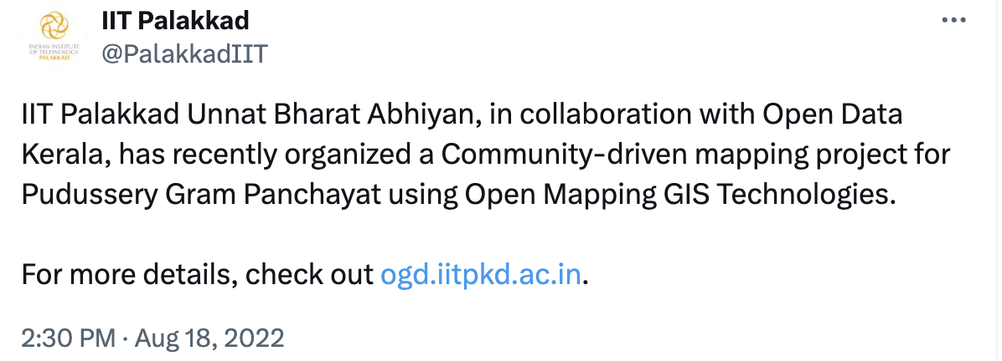
Pudussery Panchayat Mapping
Creation of selected geo-spatial open data set for Pudussery Grama Panchayat using Community Participatory Mapping
https://ogd.iitpkd.ac.in/pudussery/

Slide 22
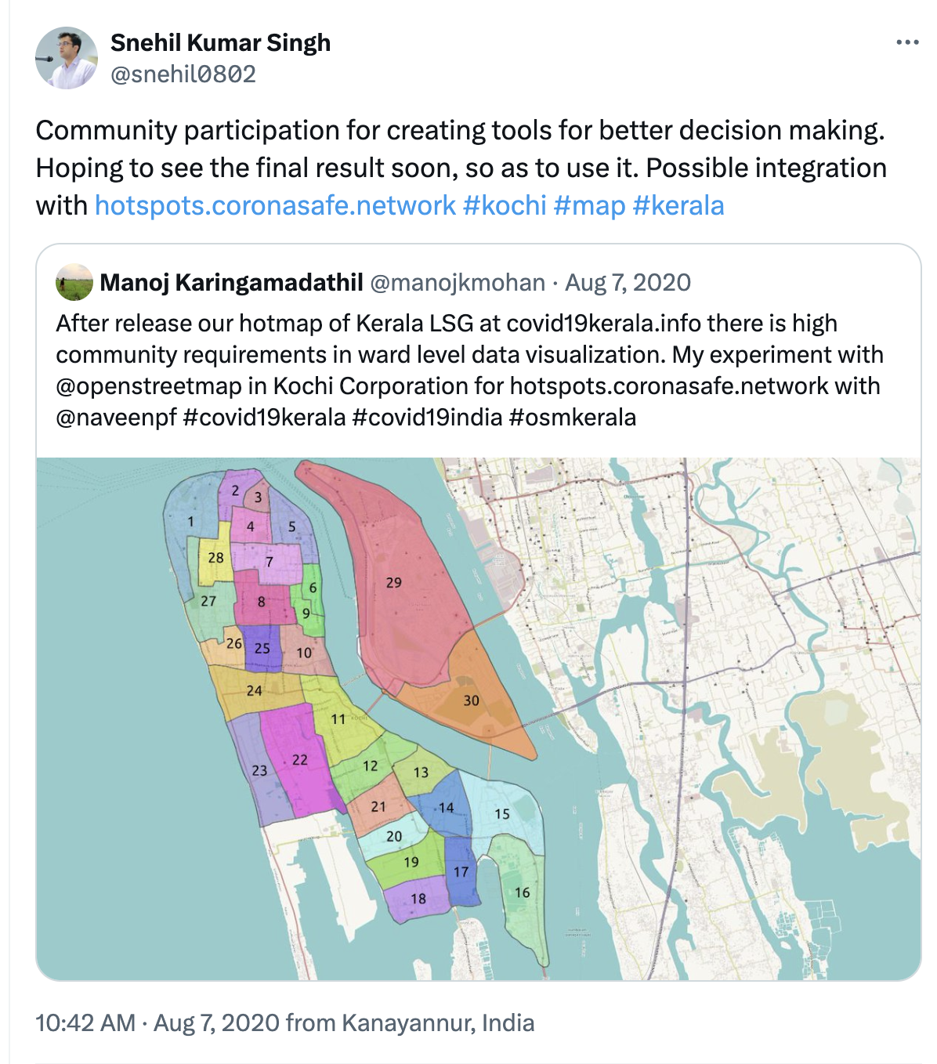
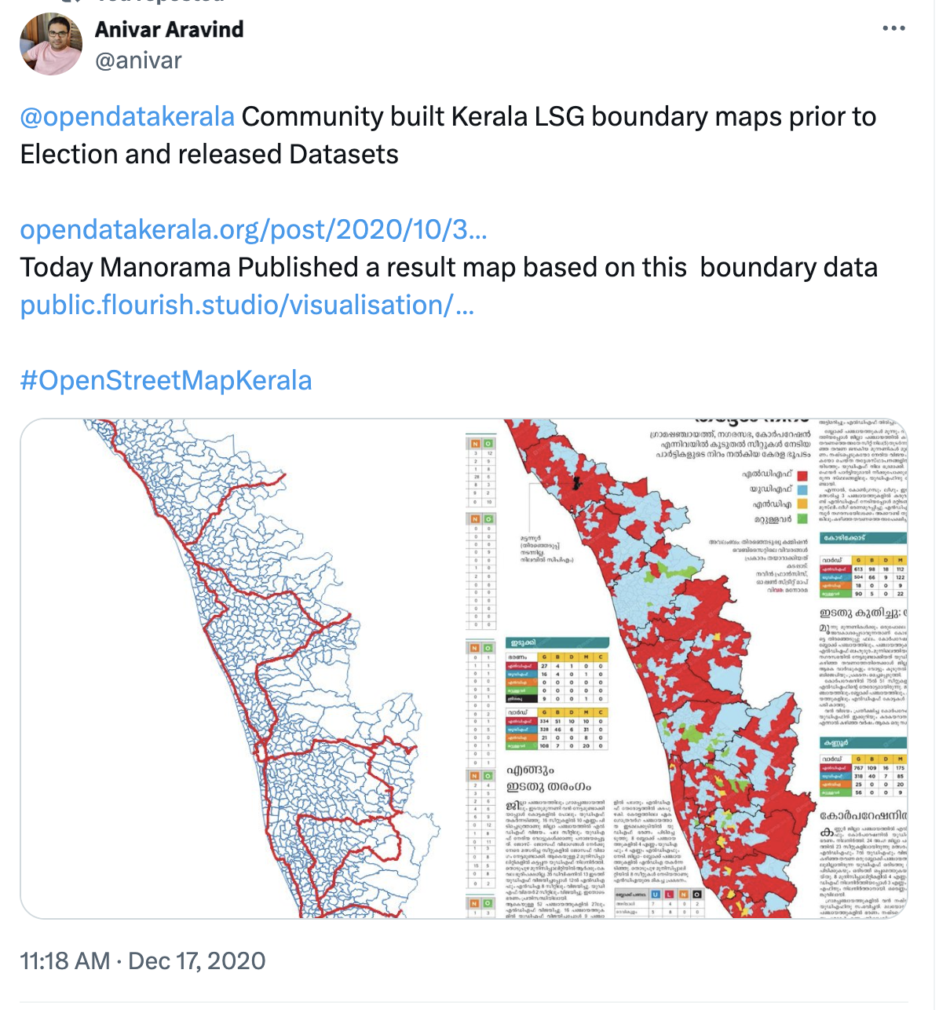
Data used
Kerala Rescue – Flood 2018
Covid19Kerala
CoronaSafe Network
Kerala Local body elections 2020

Slide 23
Companies working from India

Slide 24
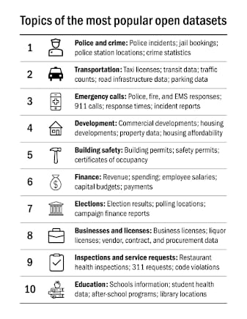
https://data.gov.in/

Slide 25
Admin Boundaries:- Districts,Taluk,Village
Political Boundaries:- Lokshaba Constituency, Assembly Constituency, Local Government Boundaries.
Schools Locations
PIN boundaries
Fire and Rescue station's locations
Police stations boundaries
Financial Insitutions – Banks, ATM location

Slide 26
Building Opendata communities like datameet, opendatakerala.
Celebrating Opendata Day
Enaging Opendata Volunteers during disaster management and building resilient comunities.
Opendata State Ranking.
Pushing state governments and local bodies to incorparate opendata policy.

Slide 27
OSM India
Website:- http://openstreetmap.in
Facebook:- OSM India Facebook group
Twitter:- https://twitter.com/osm_in
Forum:- Indian OpenStreetMap Forum
Github:- https://github.com/osm-in
Public Mailing List:- https://lists.openstreetmap.org/pipermail/talk-in/

Slide 28
Thank you

Slide 29
Puzzle Answers
Taluks in India without hospital - https://overpass-turbo.eu/s/Xe5
How many districts in India are not connected with Indian Railways? - https://overpass-turbo.eu/s/Xg4

Slide 30
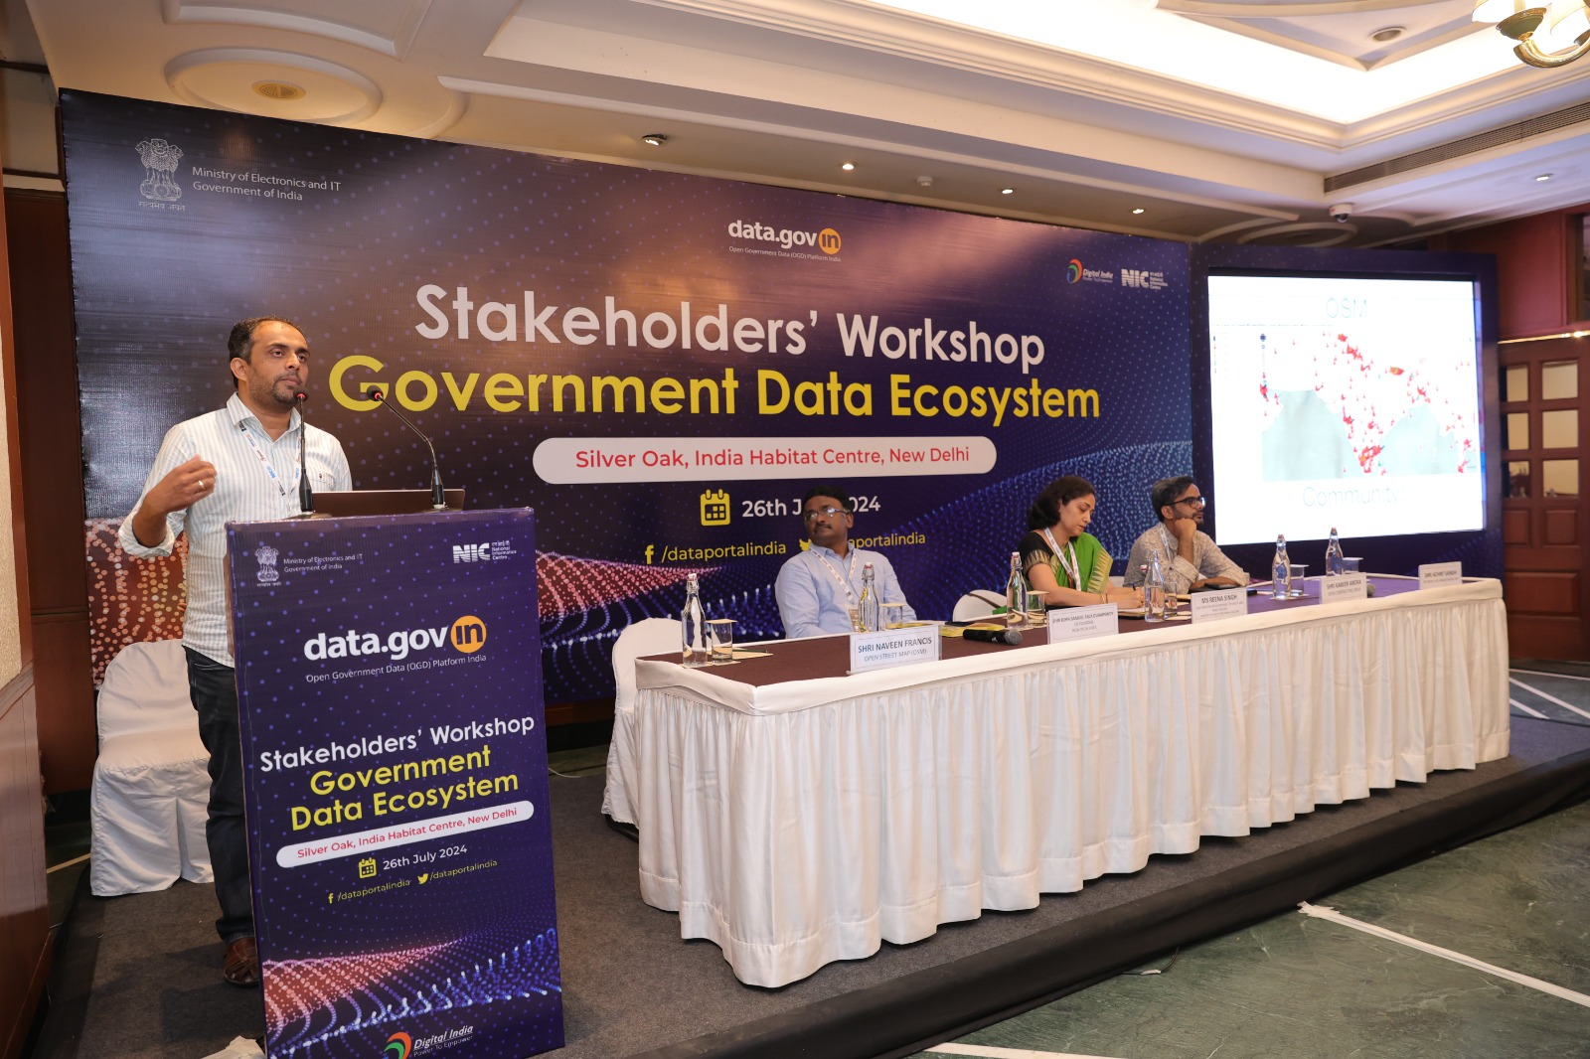
Open Government Data Platform Data Users’ Workshop
26th July 2024
Indian Habitat Centre, New Delhi

Slide 31
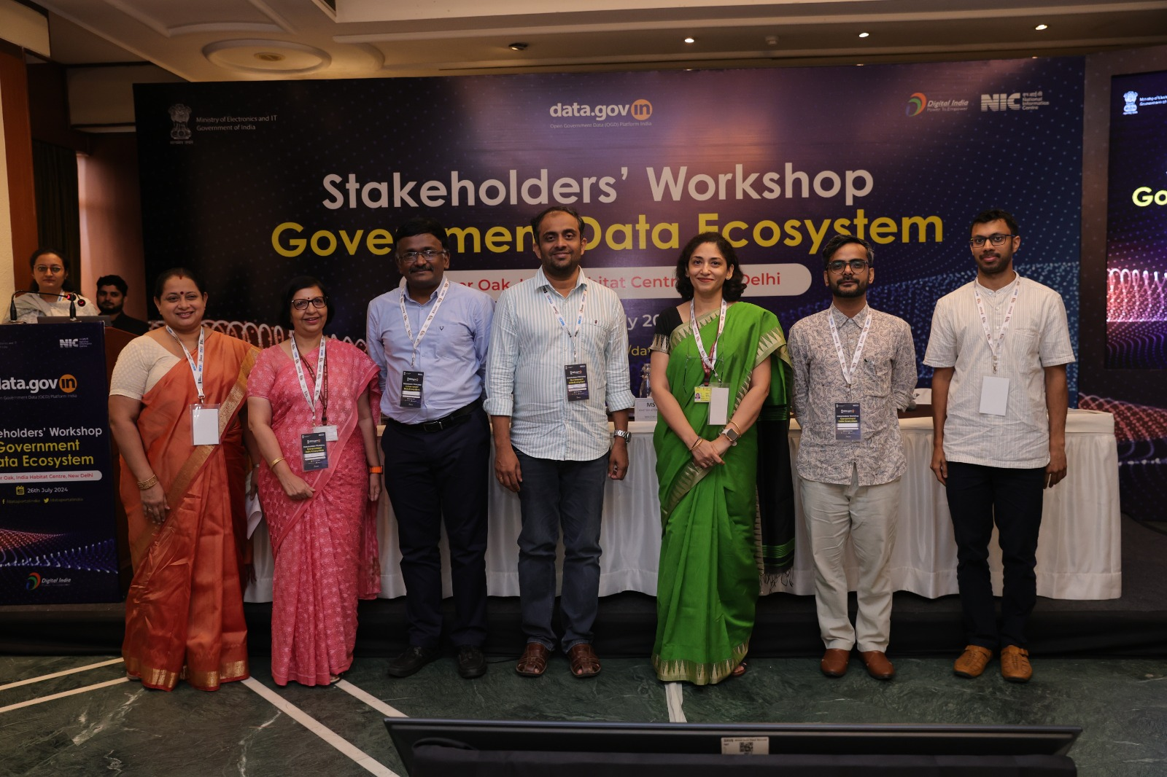
Open Government Data Platform Data Users’ Workshop
26th July 2024
Indian Habitat Centre, New Delhi

Slide 32
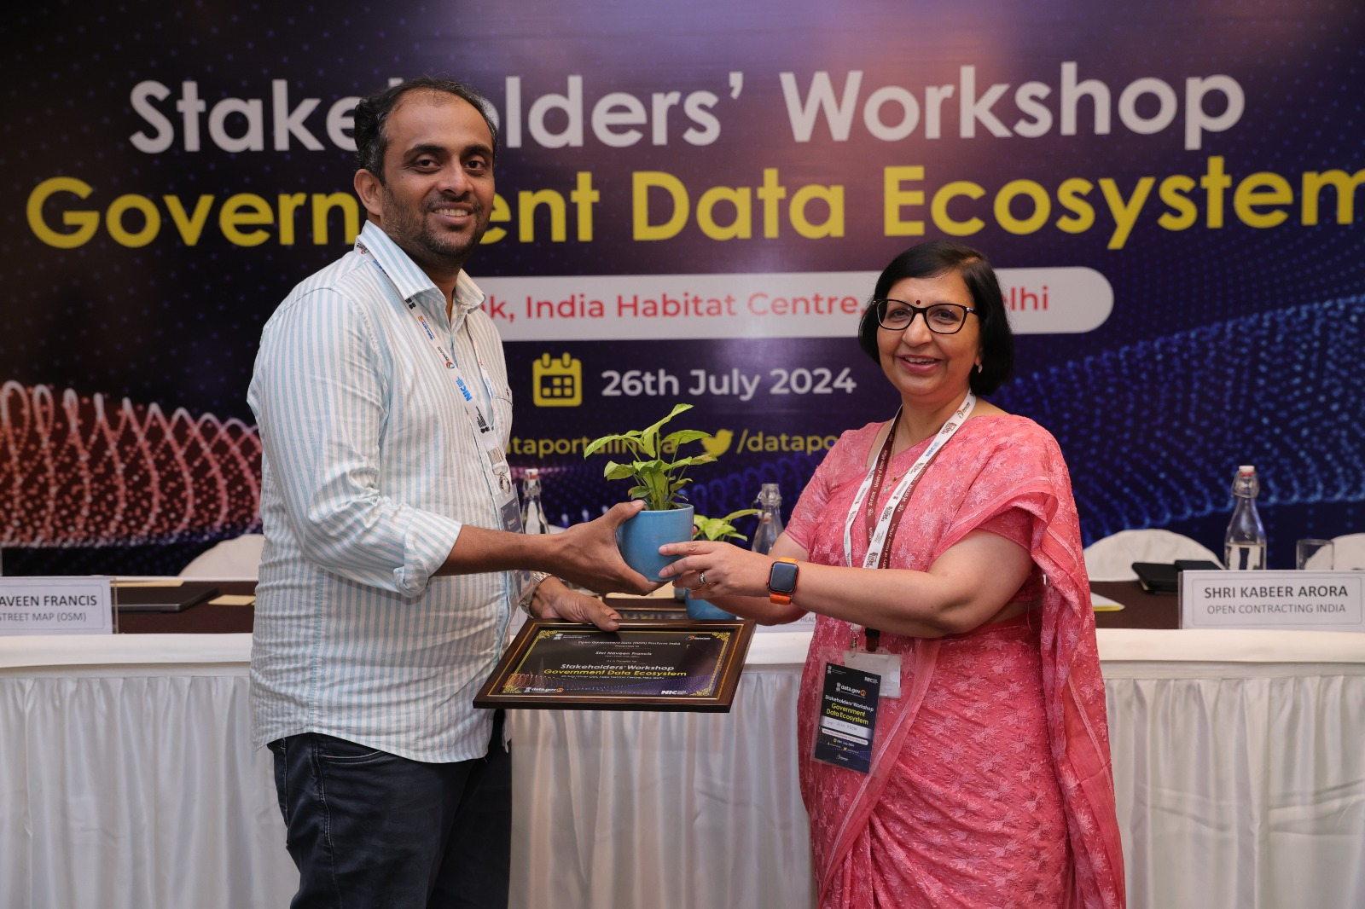
Open Government Data Platform Data Users’ Workshop
26th July 2024
Indian Habitat Centre, New Delhi

